Slide 1
SE357. Requirements Engineer Tool
Vu Tuan Hai

Slide 2
1. Introduction

Slide 3
1.1. Tool Support for Requirements Engineering
 | Word Processor | Spreadsheet | Relational Database | Requirements Management Tool
Document size | x |  |  | Not in the preformatted state
Dynamic changes over time | Possible with complex change tracking enabled |  |  | x
Release size | x | x | x | x
Requirement expansion profile |  |  | x | x
Requirements verification |  |  | Possible | Possible
Requirements volatility | x | x | x | x
Test coverage |  | Possible with complex equation logic | x | x
Test span |  | Possible with complex equation logic | x | x
Test types | x | x | x | x
Table 1. Requirements Repository Metric Capabilities

Slide 4
1.2. Capacities for RE tool
Requirements elicitation (explore)
Requirements analysis
Requirements specification
Requirements verification and validation (important)
Requirements management
Other capabilitie

Slide 5
1.3. Important features
Tool features | Description
Definition of workflow for requirements | A workflow (states, roles, state transitions) is configurable for requirements.
Automated generation of bidirectionality of traces | When the user creates a trace between artifact A and artifact B, it automatically establishes a backward trace from B to A.
Definition of userspecific trace types | An authorized user can define trace types and assign names.
Suspect traces | When a requirement changes, the tool automatically highlights all traces related to this requirement for checking and updating traces.
Long-term archiving functionality | All data in the tool can be archived in a format accessible without the tool if necessary.
Table 2. Automated Requirements Engineering Tool Features (Heindl et al. 2006)

Slide 6
1.4. List of tools
Tool name | Vender | License | Capabilities
JIRA | Atlassian | Commercial | Agile support, issue resolution management, project management, requirements management
Rational Doors Rational Rose | IBM | IBM EULA | Configurations management, requirements management, test management
Azure DevOps | Microsoft | Commercial | Agile support, issue resolution management, requirements management, test management
Jama Connect | Jama Software | Commercial | Project management, requirements management, test management
Doors Next (Jazz) | IBM | IBM EULA | Application lifecycle management, requirements management, test management
Aha! | Aha! Labs | Commercial | Product management, requirements management
Quality Center | Micro Focus | Commercial | Issue resolution management, requirements management, test management, project management
VersionOne | CollabNet | Commercial | Agile support, project management, requirements management

Slide 7
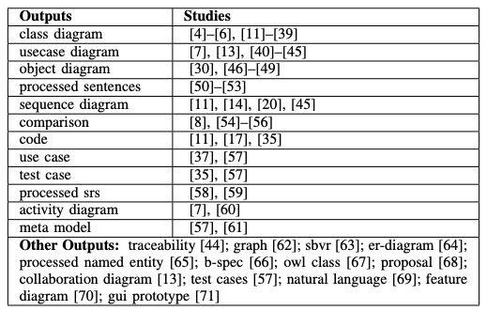
1.5. Support (advantage) tools
Tool name | Capabilities
Plantuml | Convert non-UML code to UML diagram
ArgoUML | Convert XML code to UML diagram
ABCD tool | Convert natural language to XML code
Other tools

Slide 8
1.5. Support (advantage) tools
Tool name | Capabilities
Rational Rose | Convert UML to code Convert code to UML

Slide 9
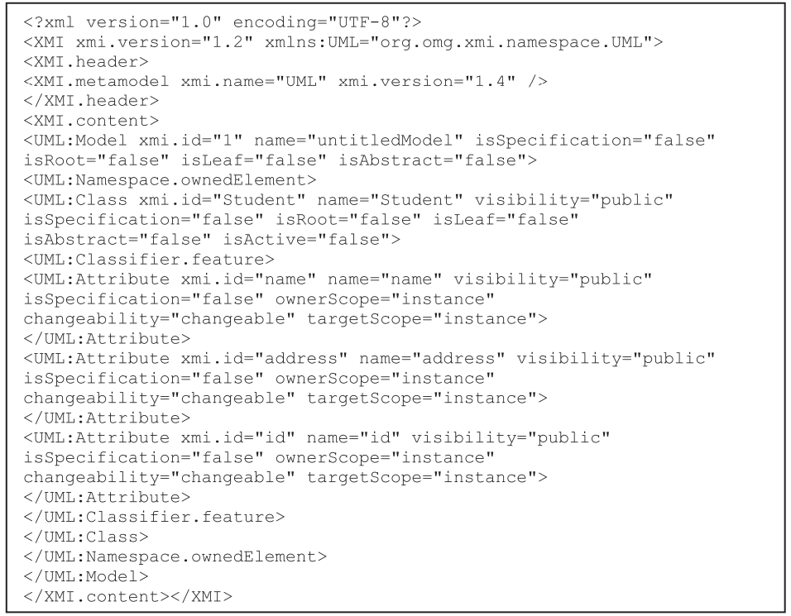
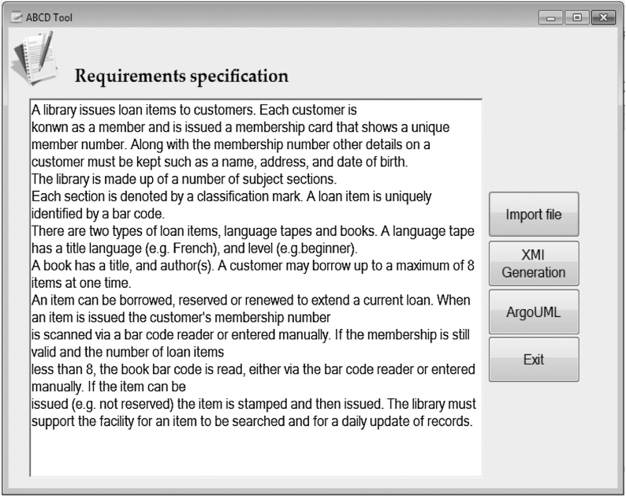
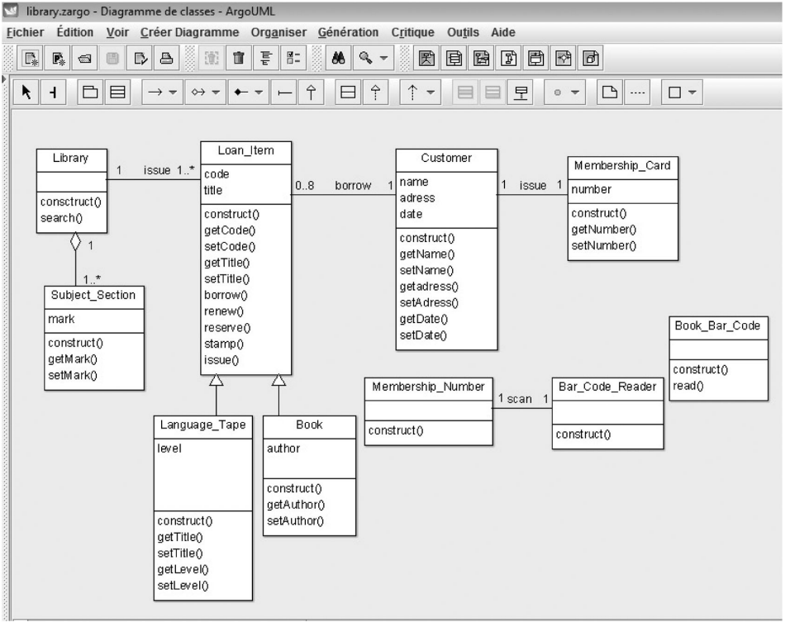

Slide 10
2. Traceability Support

Slide 11

2.1. Type of requirements traceability
Requirements traceability is concerned with the relationships between requirements, their sources, and numerous other artifacts.
Source Traceability: This provides links requirements to stakeholders who proposed these requirements
Requirements-Linkage Traceability: This provides links between dependent requirements.
Requirements-Design Traceability: This provides links from the requirements to the design.
Requirements-Source Code Traceability: This provides links from the requirements to the code.
Requirement-Test Cases Traceability: This provides links from the requirements to the test cases.

Slide 12

2.2. Type of requirement relationships
Requires
Is needed by
Supersedes (replace)
Is superseded by
Is child of
Is parent of
Refers to
Uses
Refers to
Is satisfied by
Satisfied
Contradicts with (conflict)

Slide 13

2.3. Type of requirement relationships
Example:
The system shall provide for control of the heating system and be schedulable according to the time scheduling function. (refers to)
The system shall provide for control of the heating system in accordance with the timetable shown in requirement 3.2.2 and the safety features described in requirement 4.1. (uses)

Slide 14
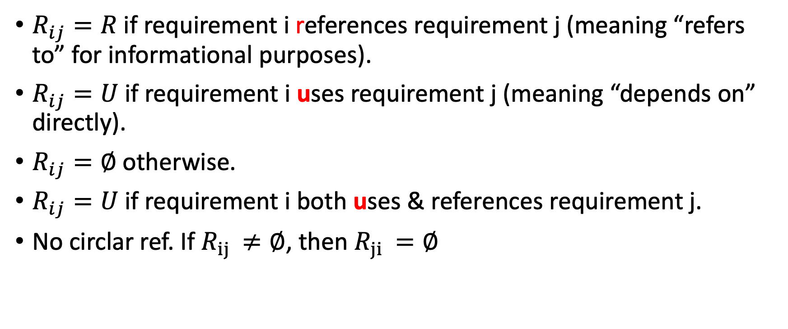
2.4. Type of requirement relationships
$R_{ij}=R$if requirement i references requirement j (meaning “refers to” for informational purposes).
$R_{ij}=U$if requirement i uses requirement j (meaning “depends on” directly).
$R_{ij}=∅$otherwise.
$R_{ij}=U$if requirement i both uses & references requirement j.
No circlar ref. If $R_{ij }≠∅$, then $R_{ji }=∅$

Slide 15
2.5.1. Requirements Linkage Traceability Matrix
Requirement ID | 1 | 2 | 3 | 4
1 |  |  | U
2 | R |  |  | R
3 |  | R
4 | R |  | U

Slide 16
2.5.2. Requirements Source Traceability Matrix
Requirement ID | Soure #1 | Soure #2 | Soure #3 | Soure #4
1 |  |  | 1
2 |  |  |  | 1
3 |  | 1 | 1
4 | 1

Slide 17
2.5.3. Requirements Stakeholder Traceability Matrix
Requirement ID | Rank 1 (lowest importance) – 5 (highest importance) | Stakeholder Source (D - Doctor, N - Nurse, A - Administrative Support Staff, P - Patient, R - Regulator)
1 | 2 | D
2 | 3 | D, N, A
3 | 2 | A
4 | 1 | P

Slide 18
3. Tool evaluation

Slide 19
3.1. Tool evaluation
Requirements traceability mechanism
Requirements analysis mechanism
Security and accessibility mechanism
Portability and backend compatibility
Configuration management approach
Communication and collaboration mechanism
Change management support
Online publishing support
Usability features such as word processor compatibility
SRS documentation format

Slide 20

3.2. Tool evaluation
Organization of requirements with metadata, attributes, and reuse
Reports, database queries, and open interface language
Internal checks, that is, consistency, dependencies, and history
Traceability support, that is, drag and drop (horizontal and vertical)
Providing support for reuse
Remote working, cloud only
Multiple views of requirements
Performance
Collaboration, workflow management
Easily adapted and integrated into business processes
Federation and notification with ALM/PLM tools
Export/import with standard formats
Macros for repeated commands
Training and learning curve effort
Agile, CI/CD, and DevOps
Intelligent support
Scalability

Slide 21
4. Requirement metrices

Slide 22
4. Metrics (Costello and Liu (1995))
Volatility
Traceability
Completeness
Defect density
Fault density
Interface consistency
Problem report and action item issues

